Slide 3
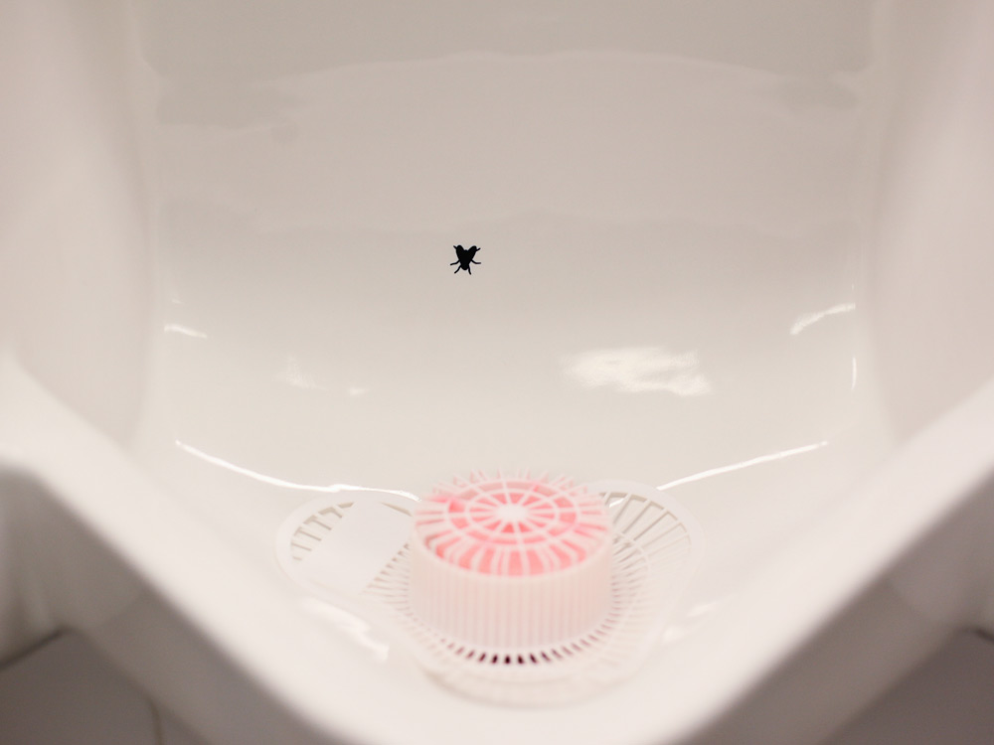

Slide 4
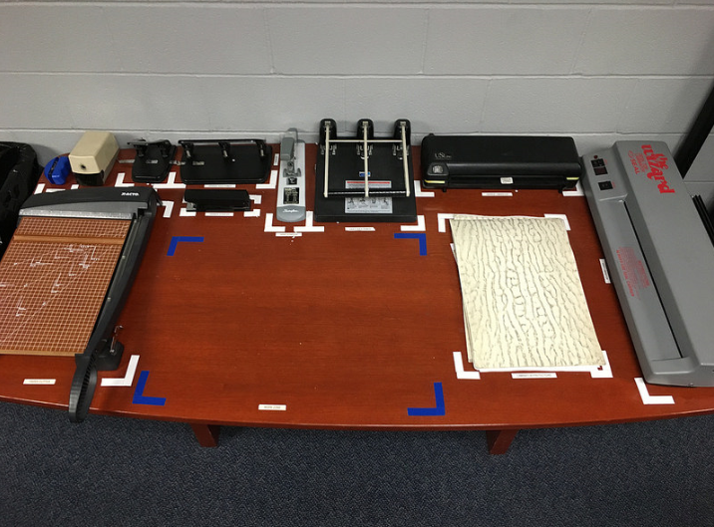

Slide 5
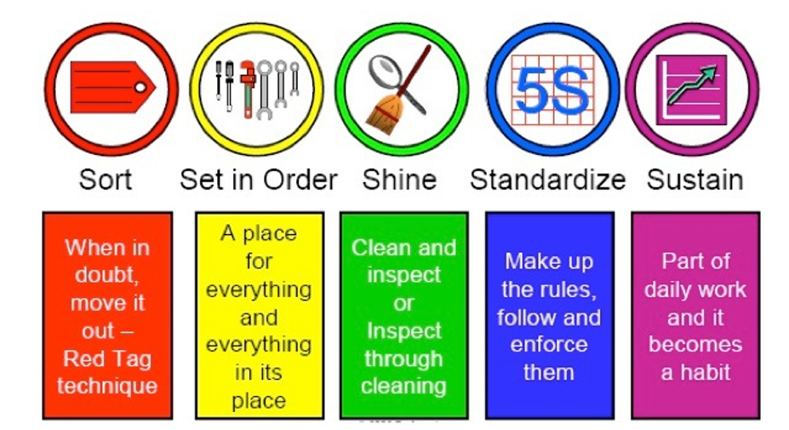

Slide 6
Red Toolbox Blue Toolbox Tool Board
Order | Tool | Correct?
1. | 1/2” Box End Wrench | Yes / No
2. | 3/8” Drive Ratchet Handle | Yes / No
3. | 3/8” Drive 3” Extension | Yes / No
4. | 1/4” Drive 17/32” Socket | Yes / No
5. | T40 Torx Drive Bit | Yes / No
6. | 3/8” to 1/4" Drive Adapter (AD) | Yes / No
7. | 5.5 mm Hex Key | Yes / No
8. | 1/4" Drive 7mm Socket | Yes / No
9. | 10mm Box End Wrench | Yes / No
10. | #2 Phillips Driver Bit | Yes / No
Total Time:

Slide 7
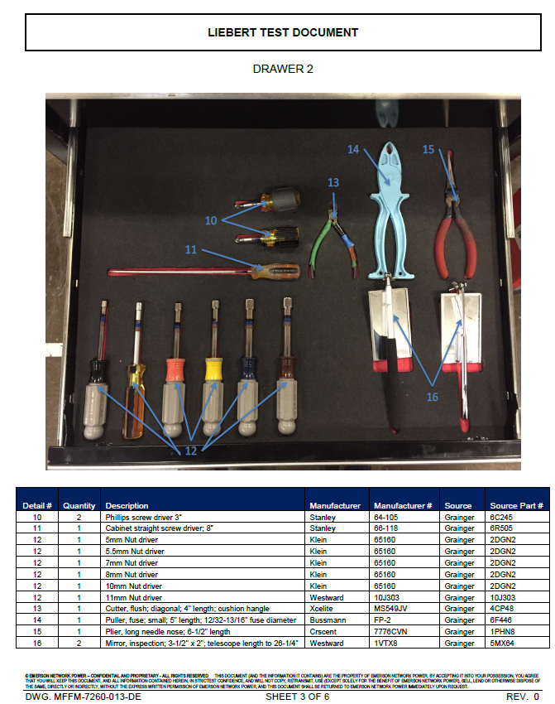
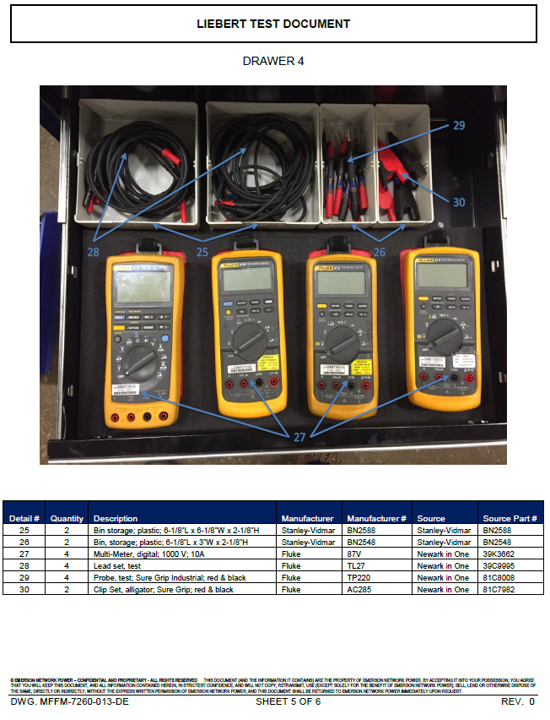

Slide 9
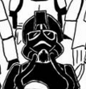
Imperial Pilots
Scout Troopers
Stormtroopers
Snowtroopers

Slide 10
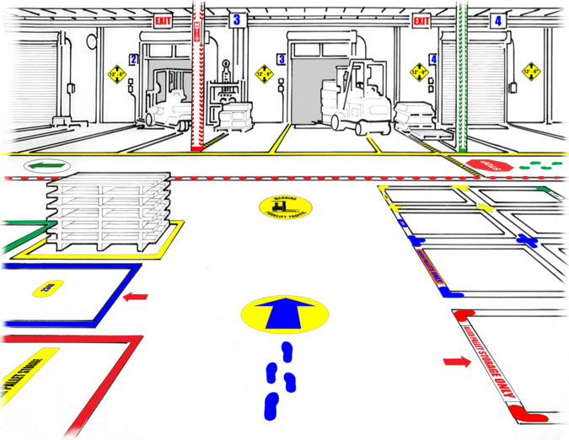
standardize

Slide 12
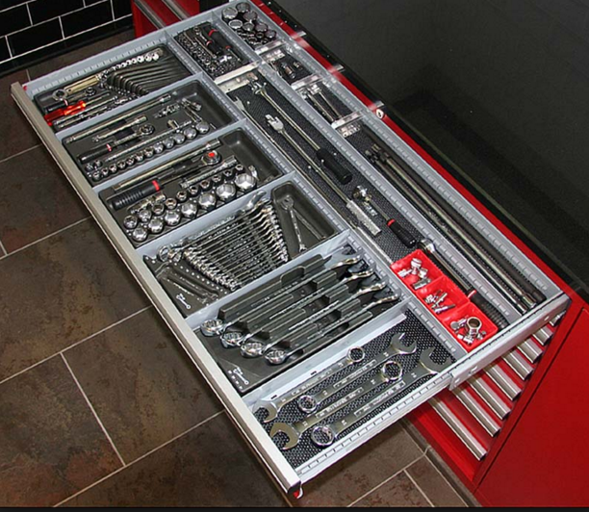
Set in order

Slide 13
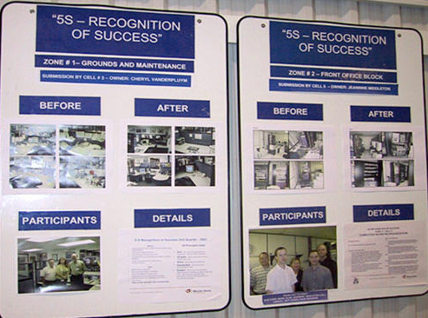

Slide 14
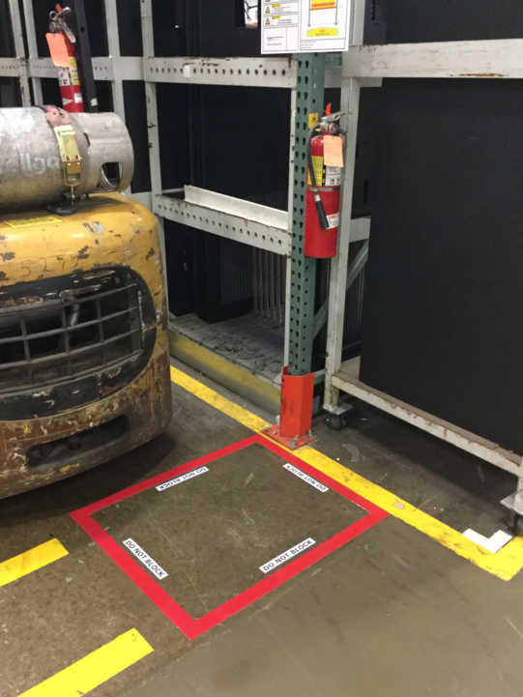

Slide 15
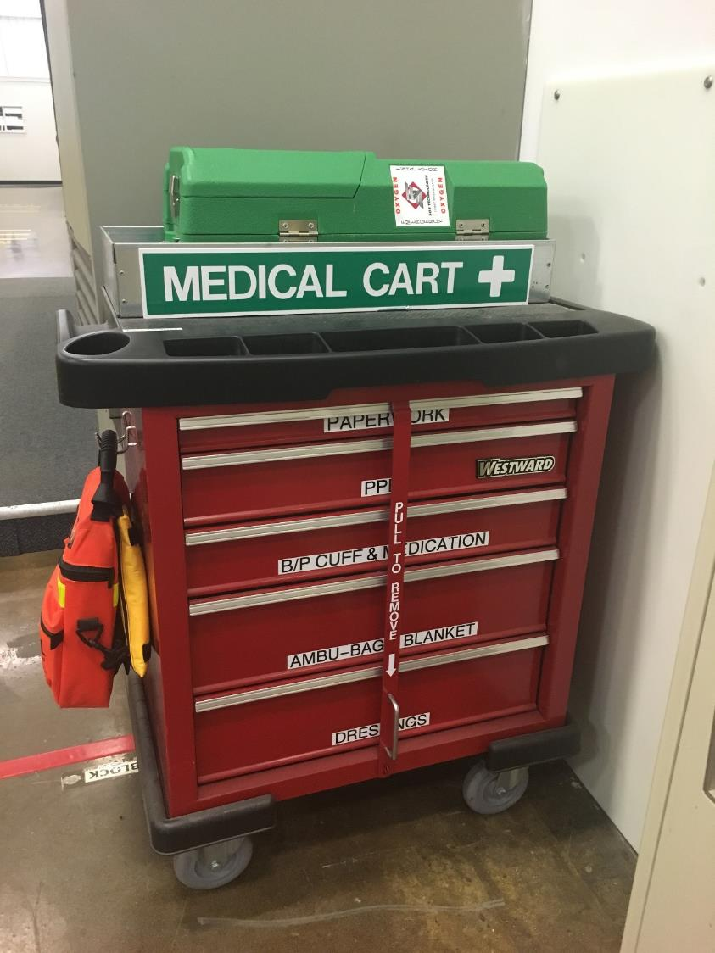

Slide 16
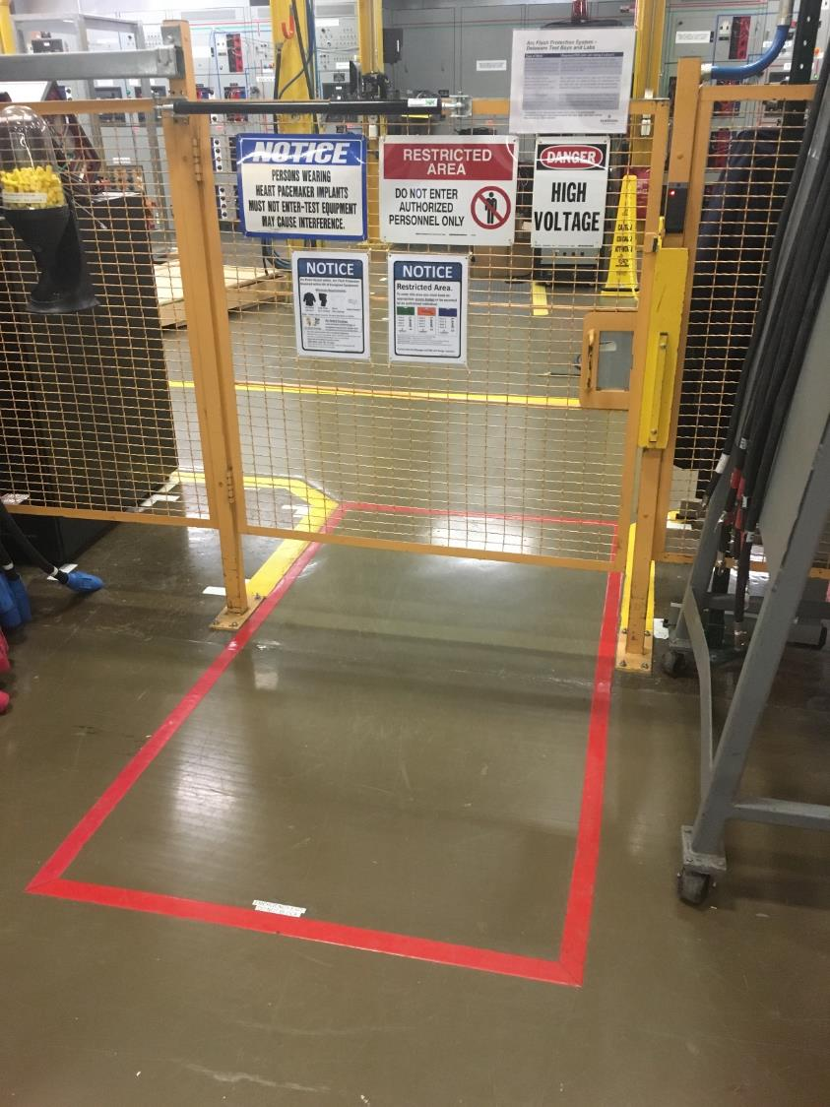

Slide 17
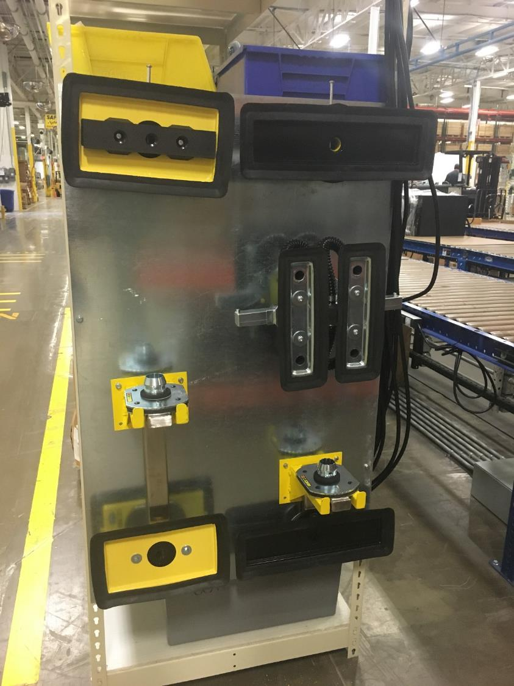

Slide 18
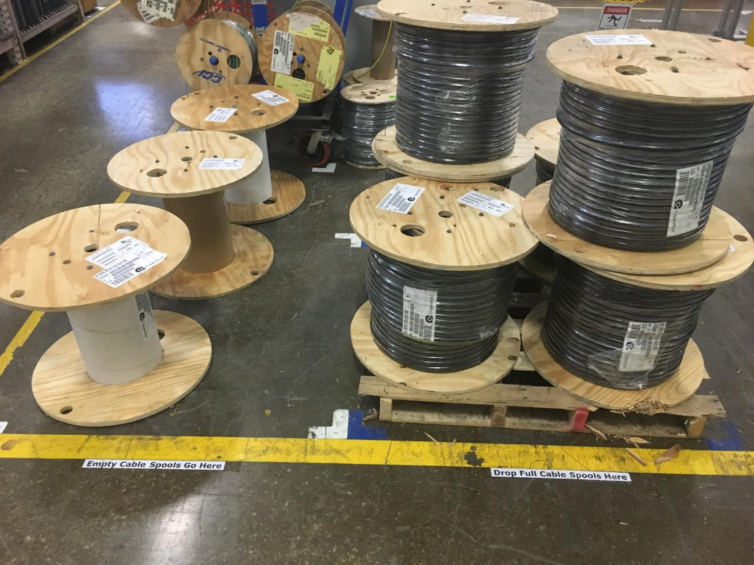

Slide 19
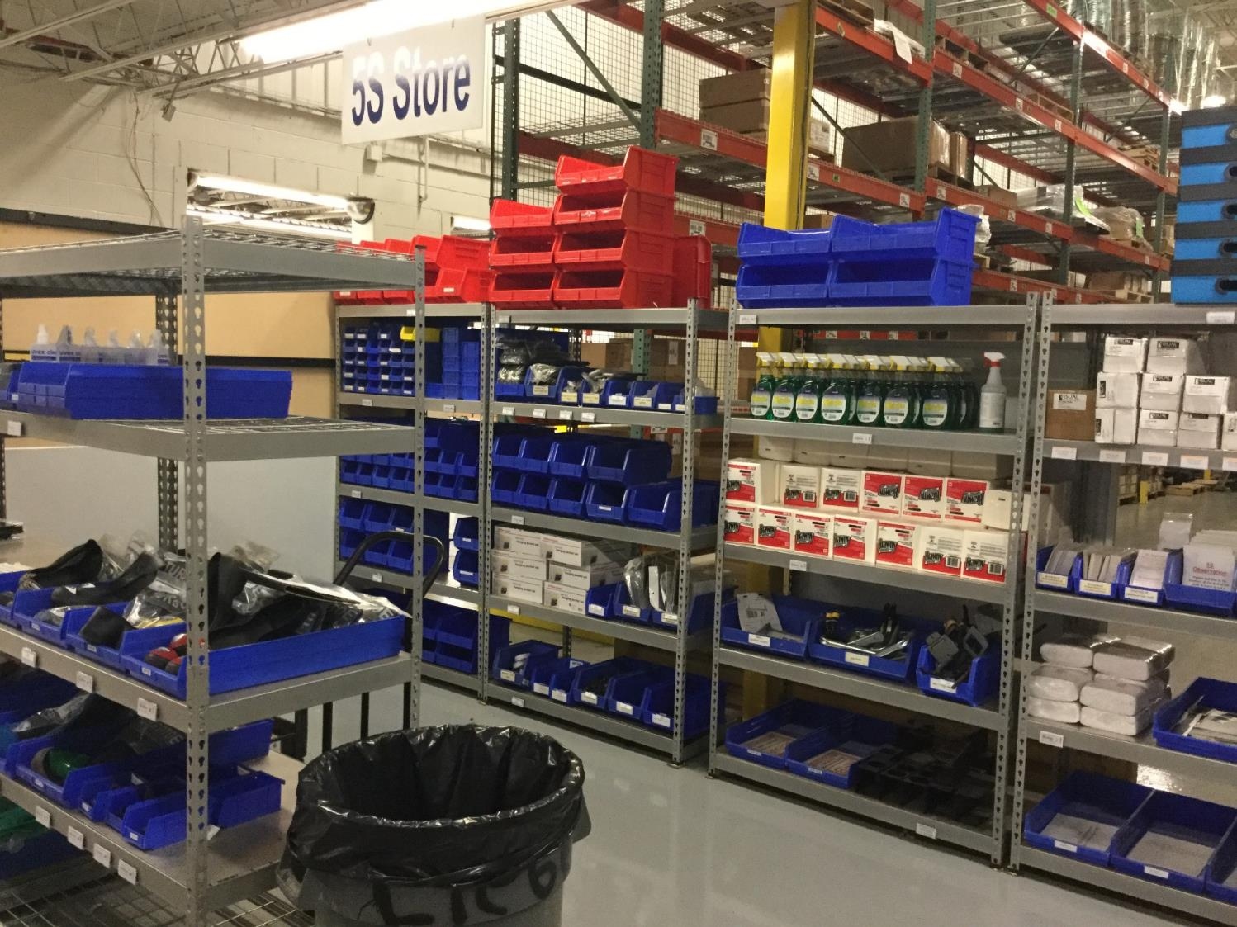

Slide 20
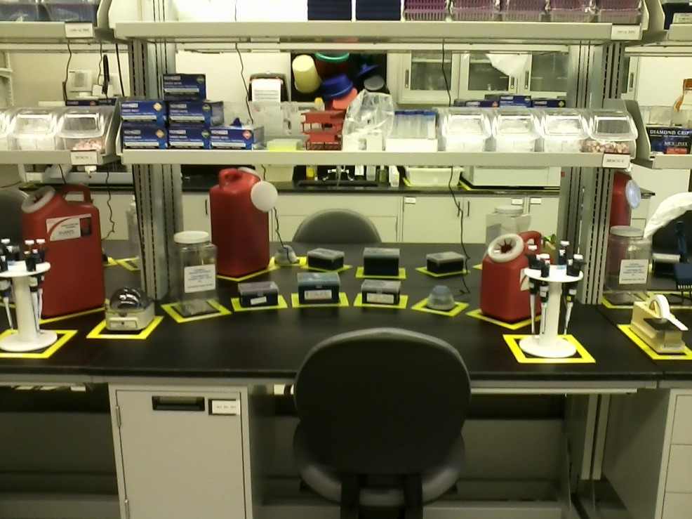

Slide 21
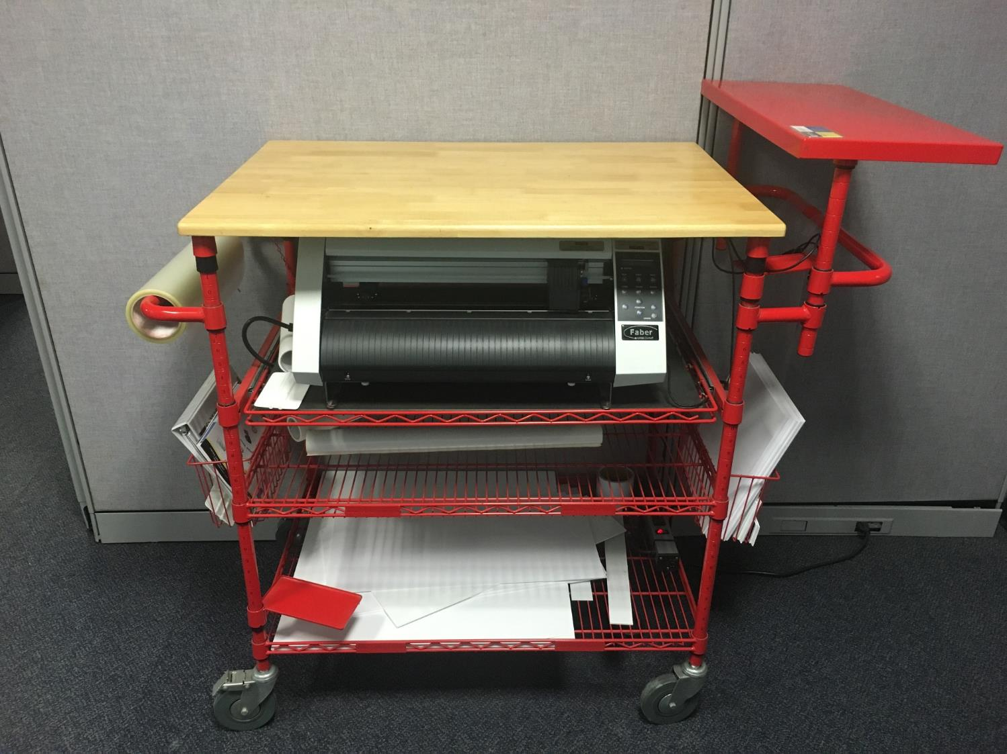

Slide 22
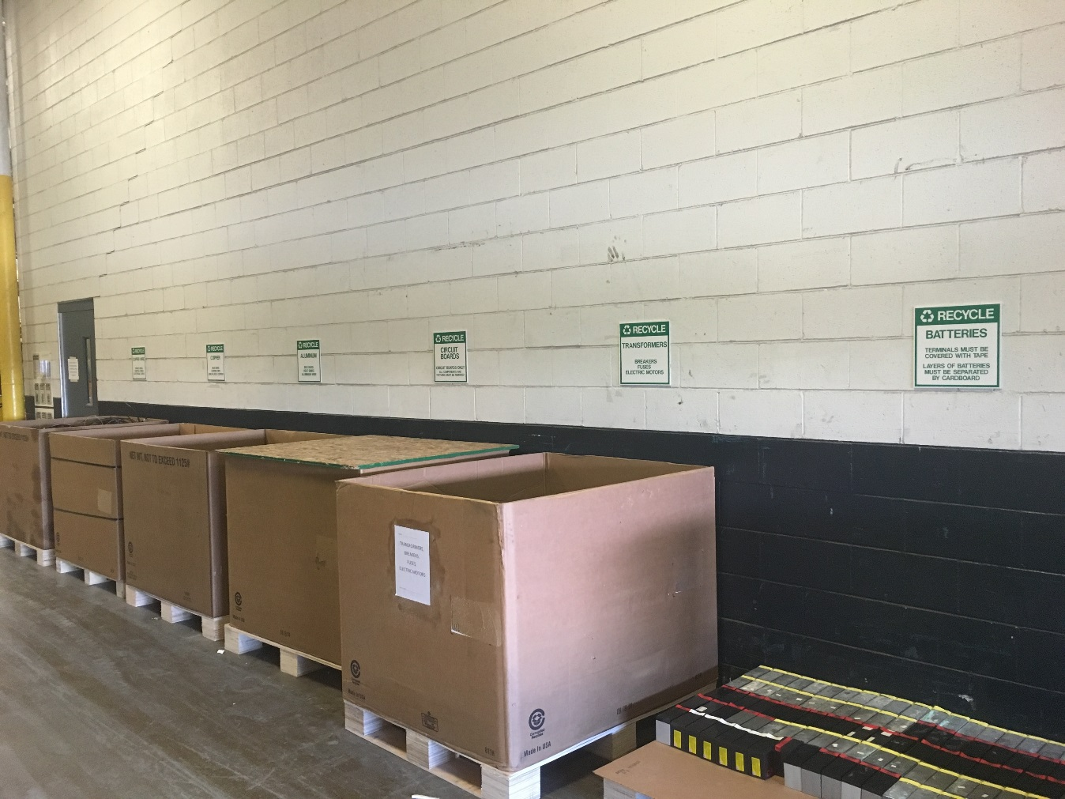

Slide 23
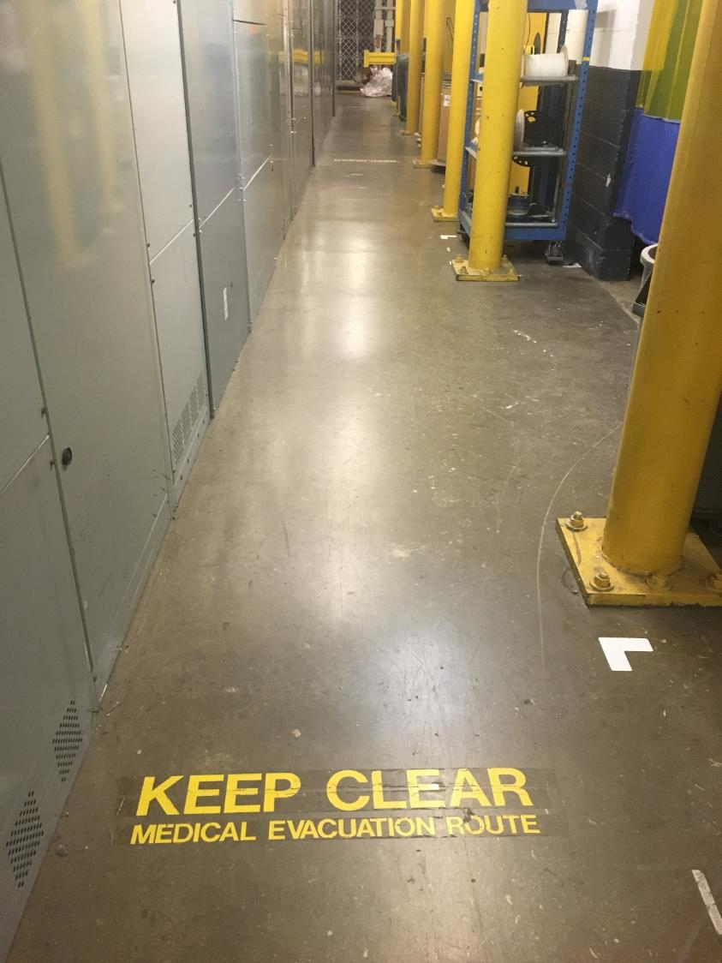

Slide 24
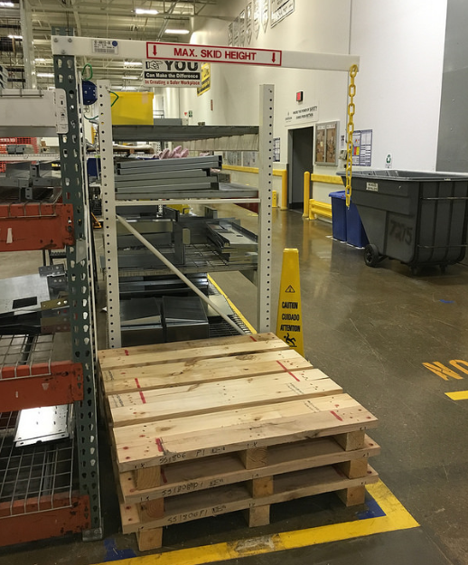

Slide 25
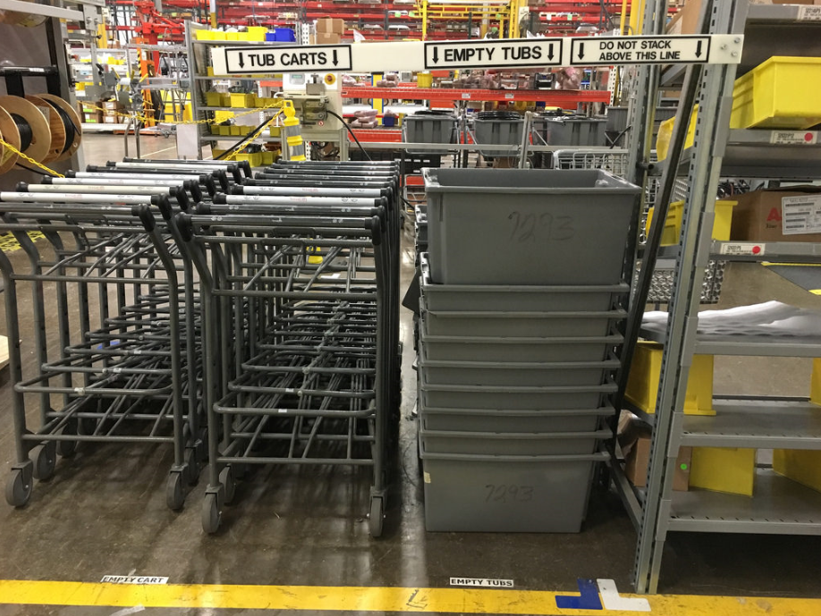

Slide 26
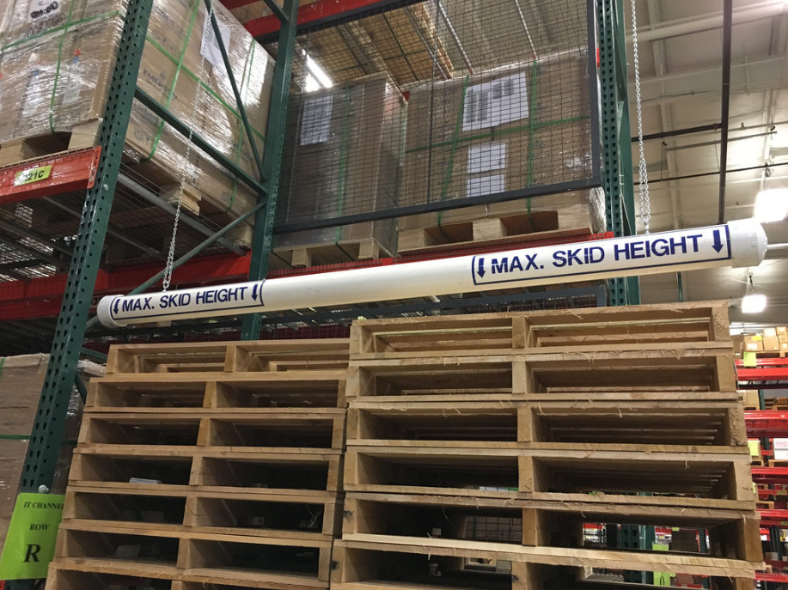

Slide 27
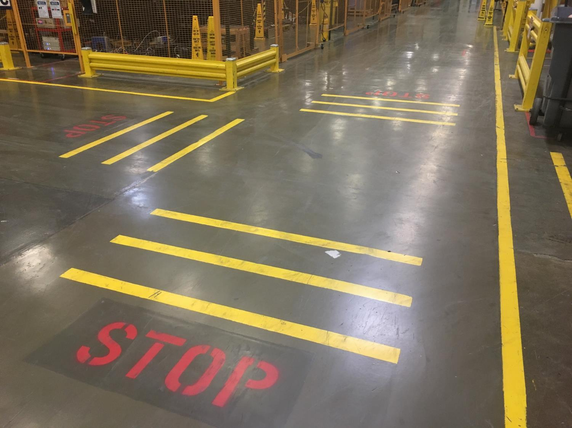

Slide 28
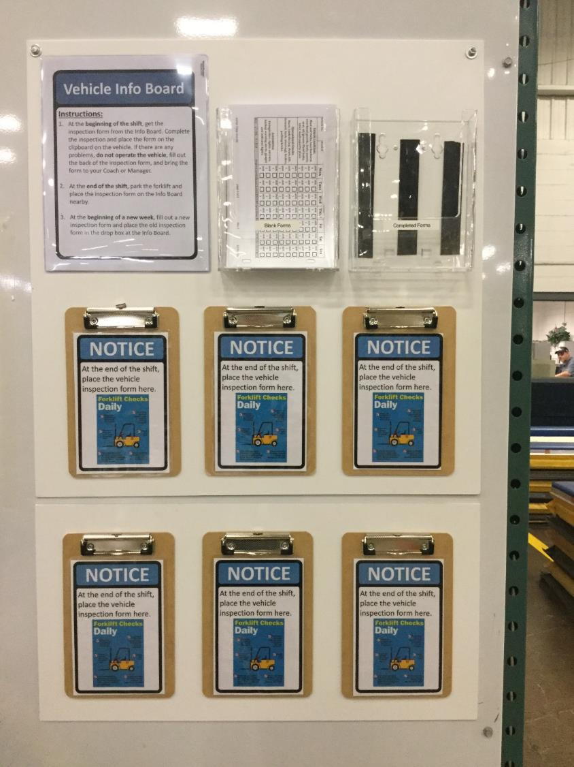

Slide 29
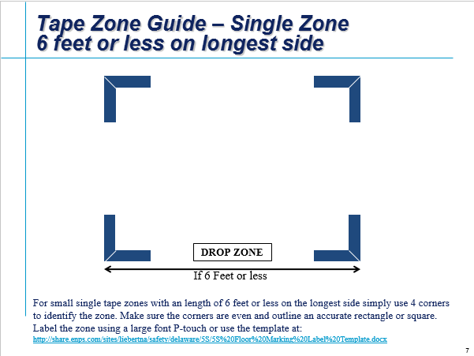

Slide 31
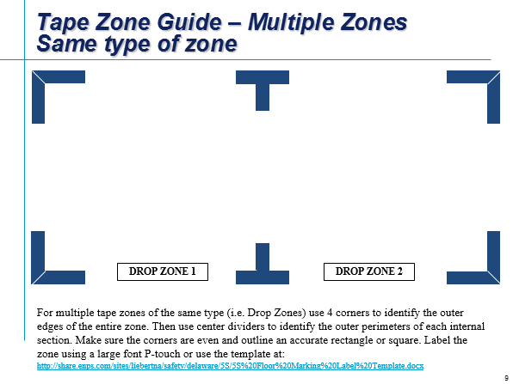

Slide 35
5S Resources - Best

Slide 36
5S Resources - Good

Slide 37
Other Excellent 5S (Leadership) Resources

